Slide 1
The Children’s code
Age group 11-14

Slide 2
Introduction
In September 2021, the ICO launched new rules governing how online services collect and use children and young people’s personal data.
These rules are known as the Children’s code, and are designed to protect children and young people’s personal data.
This resource follows on from the Your Data Matters school resources, and aims to make your students aware of what the Children’s code is, and how it affects them.
There is an accompanying downloadable document, The Children’s code - summary, which outlines some key information about the Children’s code.
Age: Students aged 11 to 14
Timings: 60 minutes Resources:
Children’s code presentation
Personal data mind map
Kayla’s story scenario sheet and support sheet option
The Children’s code - a summary
Tips for creating a poster campaign
Infographic - for sending home to parents
Guidance for Teaching:
Take time to set clear ground-rules around listening, respect and not to use personal or sensitive examples.
Create a positive classroom culture where students feel able to ask questions and also have the right to pass if they don’t feel comfortable answering a question.
Ensure you are familiar with your school’s safeguarding policy and procedures, including what do if a student makes a disclosure.
Ensure that any other whole school policies are followed, such as e-safety.

Slide 3
Introduction
vv
vv
“This resource about the Children's code is excellent - the information is broken down well and is accessible to young people.
The resource will make students more aware about the personal data that they share and highlights the important issues that we all need to be aware of in an ever-changing digital world."
Mrs Siobhan Gillen, School Principal
vv
Notes:
About this lesson This resource has been developed with guidance from the PSHE Association, Department for Education (England), Department for Education and Skills (Wales), Education Scotland and the Department of Education (NI).
The Children’s code infographic can be sent home to parents, to encourage students to continue the discussion at home.

Slide 4
Curriculum links
England
DFE RSE and Health Guidance:
Pupils should know:
how information and data is shared and used online.
Ofsted personal development judgement
Schools support pupils to develop in many diverse aspects of life including:
enabling pupils to recognise online and offline risks to their well-being and making them aware of the support available to them
enabling pupils to recognise the dangers of inappropriate use of mobile technology and social media.
Curriculum Links to PSHE programme of Study:
KS3
H30. how to identify risk and manage personal safety in increasingly independent situations, including online
KS4 L22. that there are positive and safe ways to create and share content online and the opportunities this offers
Notes:
Curriculum links for England.

Slide 5
Curriculum links
Wales
Digital Competence Framework – Citizenship
Year 7
Explain how their digital usage is tracked, e.g. know basic data protection laws and how organisations are responsible for the security of collected data.
Year 9
Understand that they have a digital footprint and that this information can be searched, copied and passed on.
Year 10
Recognise the risks and the uses of data/services on personal devices within the terms and conditions of a range of software and web services.
Year 11
Identify and describe the data protection policies of a variety of organisations located in different countries, and how this affects the way that they work.
Identify how organisations become data compliant when using multi-national products.
Scotland
Technologies - Digital Literacy
Cyber resilience and internet safety
Second level
I can explore online communities demonstrating an understanding of responsible digital behaviour and I’m aware of how to keep myself safe and secure.
Third level
I can keep myself safe and secure in online environments and I am aware of the importance and consequences of doing this for myself and others.
Northern Ireland
Digital Skills at KS3
Digital Citizen
Engage with digital technology safely and meaningfully, including capturing photographs and videos.
Avail of digital services and use them safely and in accordance with the law.
Consider the moral and ethical impact of digital technology on society.
Notes:
Curriculum links for Wales, Scotland and Northern Ireland.
Curriculum for Wales - The Health and Well-being Area of Learning and Experience
https://hwb.gov.wales/curriculum-for-wales/health-and-well-being
In the new Curriculum for Wales, the Health and Well-being Area of Learning and Experience is about developing the capacity of learners to navigate life's opportunities and challenges. Relationships and Sexuality Education (RSE) will be a mandatory requirement in the new curriculum.
Further guidance to practitioners underlines the importance of developing safe behaviour in relation to digital media and the online world. Learners should be encouraged to develop their understanding of the increasing influence of technology on their daily lives and the implications this may have for their health and well-being, in particular the possible impact on physical, mental and emotional health and well-being. Decision-making, risk assessment and safe and unsafe situations and interactions should all be considered in digital contexts. This includes relationships with others, online safety, legal implications and social influences online (including social media).
³The PSE framework will be superseded by the Curriculum for Wales.
⁴A revised version of the Digital Competence Framework is available to support the Curriculum for Wales and opportunities to develop digital competence across all areas of learning and experience.

Slide 6
Learning objective
Students will learn how the Children’s code protects children and young people’s digital rights and wellbeing.
?
Learning outcomes
Students will be able to:
!
!
!
describe what the Children’s code is
explain how the Children’s code protects young people’s data rights
identify where to go for help and support.
Notes:
Learning objective and outcomes
Talk through the learning objective and outcomes. Explain to students that this lesson follows on from their previous lesson/s about personal data and data protection. They are going to learn about a set of rules called the Children’s code that are specifically designed to keep children and young people’s personal data safe.
Remind students that although it is online companies’ responsibility to adhere to these rules, there are also steps that children and young people can take to ensure their data remains protected online.

Slide 7
Take a guess!
What percentage of young people aged 12 - 15:
?
?
use social media sites or apps
play games online
?
use video sharing platforms, such as YouTube
87%
80%
99%
Notes:
Ice-breaker (5 minutes)
Use this short quiz slide as an ice-breaker to introduce the topic and start a discussion with students about how young people use the internet.
Can students think of other things that young people use the internet for, aside from what has been mentioned on this slide? Create a board blast using sticky notes.
Ask students if they can think of ways that young people can keep themselves safe and secure when they go online? (Students may volunteer answers that relate to personal data, such as using secure passwords and keeping profiles private, otherwise introduce the concept of ‘personal data’ using the next slide.)
Keep in mind that students will have had different levels of exposure to the internet; some may not have social media or gaming accounts, and therefore be less familiar with the topic than others.
Data taken from https://www.ofcom.org.uk/__data/assets/pdf_file/0025/217825/children-and-parents-media-use-and-attitudes-report-2020-21.pdf.

Slide 8
Take a guess!
The most popular type of content among young people aged 5 to 15 on video sharing platforms, such as YouTube, is:
?
?
?
Music videos
Funny videos, jokes, pranks or challenges
Funny videos, jokes, pranks or challenges
?
‘How to’ tutorials
Notes:
Ice-breaker (5 minutes)
Use this short quiz slide as an ice-breaker to introduce the topic and start a discussion with students about how young people use the internet.
Can students think of other things that young people use the internet for, aside from what has been mentioned on this slide? Create a board blast using sticky notes.
Ask students if they can think of ways that young people can keep themselves safe and secure when they go online? (Students may volunteer answers that relate to personal data, such as using secure passwords and keeping profiles private, otherwise introduce the concept of ‘personal data’ using the next slide.)
Keep in mind that students will have had different levels of exposure to the internet; some may not have social media or gaming accounts, and therefore be less familiar with the topic than others.
Data taken from https://www.ofcom.org.uk/__data/assets/pdf_file/0025/217825/children-and-parents-media-use-and-attitudes-report-2020-21.pdf

Slide 9
Take a guess!
What percentage of young people aged 12 - 15 have seen worrying or nasty content online?
?
?
?
11%
31%
31%
?
25%
Notes:
Ice-breaker (5 minutes)
Use this short quiz slide as an ice-breaker to introduce the topic and start a discussion with students about how young people use the internet.
Can students think of other things that young people use the internet for, aside from what has been mentioned on this slide? Create a board blast using sticky notes.
Ask students if they can think of ways that young people can keep themselves safe and secure when they go online? (Students may volunteer answers that relate to personal data, such as using secure passwords and keeping profiles private, otherwise introduce the concept of ‘personal data’ using the next slide.)
Keep in mind that students will have had different levels of exposure to the internet; some may not have social media or gaming accounts, and therefore be less familiar with the topic than others.
Data taken from https://www.ofcom.org.uk/__data/assets/pdf_file/0025/217825/children-and-parents-media-use-and-attitudes-report-2020-21.pdf.

Slide 10
Personal data?
Complete the Personal data mind map by answering the following questions:
What is personal data?
What do online companies use their users’ personal data for?
What examples of personal data can you think of?
How could someone keep their personal data private?
Notes:
Baseline assessment (10 minutes)
Hand out the Personal data mind map for students to complete in pairs or small groups. Use the exercise as a baseline assessment to assess how much students know or remember about personal data, which is covered in the Your Data Matters secondary school resources.
As a class fill out the ‘What is personal data?’ question on the mind map, and then ask students to work in pairs or groups of three to fill out the rest of the mind map.
Ask students to share their answers and recap the key points using the next slide.

Slide 11
Personal data?
Complete the Personal data mind map by answering the following questions:
Answers
Answers
Answers
What examples of personal data can you think of?
Name
Birthday
Age
Gender
Email
Address
Location
Online history or behaviour e.g. films watched on a streaming platform
Answers
What is personal data?
What do online companies use their users’ personal data for?
What do online companies use their users’ personal data for?
Personalise their services e.g. when video streaming services recommend content based on users’ viewing history
Targeted advertising
Communicate with their users
How can you keep your personal data private?
Use strong passwords
High privacy settings
Only sign up to websites and apps you trust
Turn off location tracking unless it’s needed
Turn off profiling
Avoid giving out more personal data than is needed
What is personal data?
Personal data is any information about who you are and what you do.
What examples of personal data can you think of?
How could someone keep their personal data private?
Notes:
Baseline assessment – answers Ask students to share their mind map answers, and recap the key points using this slide.
Challenge question
Why is it important that people’s personal data is protected when they go online?
(Personal data is very valuable to online companies, it can be used commercially for example to target consumers with advertising or emails. Keeping data private protects a person from intrusive advertising from companies they may not want to hear from, and from having sensitive information made public. Companies are required by law to keep their users’ personal data safe, to protect it from hackers and people with criminal intent who try to steal and sell people’s data. Keeping personal data safe also protects people from being a victim of identity theft. Identity theft is when someone steals another person’s personal data - such as name, email address, bank details - in order to imitate them online, steal from them or apply for documentation such as passports or credit cards).
Explain that there are now special rules for how online companies have to treat children and young people’s personal data, in order to keep it safe and secure. These rules are collectively known as ‘The Children’s code’ and they have been developed by the ICO, the organisation that is responsible for keeping personal data safe.

Slide 12
Children’s code
vv
vv
In September 2021, the ICO launched a set of 15 rules that govern how online companies have to treat children and young people’s personal data.
Collectively the rules are known as ‘the Children’s code’. The code aims to make sure that children and young people’s digital rights are protected when they go online.
Until the code was developed, children and young people didn’t have much choice about how their personal data was used. Now, they have greater protection and control over what data they give away.
The ICO is an independent authority that is responsible for protecting data rights in the UK.
vv
Notes:
The Children’s code
Introduce the concept of the Children’s code using this slide.

Slide 13
Think, pair, share
In pairs, discuss the following:
Why do you think there are laws about how companies treat personal data?
Why do you think children and young people’s data is treated differently?
Notes:
Think, pair, share (10 - 15 minutes)
This activity uses a think, pair, structure to get students thinking about why there are special laws that govern how online companies treat personal data, and in particular children and young people’s data.
If time allows, ask students to join their pairs together to form small groups, and come up with suggestions for rules that could be put in place to safeguard children and young people online.
Why do you think there are laws about how companies treat personal data? GDPR is a set of rules developed by the European Union that determine how personal data has to be kept safe, for example, by businesses or organisations. Personal data, such as email addresses or medical records, must be kept private and secure by law, in order to comply with GDPR. This protects individuals by making sure that information they want will stay private, such as medical records, does not get made public, and it means that businesses cannot contact consumers by email without their prior consent. Anyone has the legal right to unsubscribe from any mailing list under GDPR, which protects the consumer from being bombarded with intrusive messaging.
Why do you think children and young people’s data is treated differently? The United Nations Convention on the Rights of the Child (UNCRC) recognises that children need special safeguards and care in all aspects of their life. When children and young people go online they can end up sharing personal information without understanding the implications. They may also be more susceptible to techniques used by online companies to encourage them to spend more time on apps and websites, or make purchases. The Children’s code therefore requires that digital design prioritises the health and wellbeing of the child.

Slide 14
Think, pair, share
In pairs, discuss the following:
Next step
Join together with another pair and imagine that you have been tasked with creating the Children’s code.
What rules would you put in place for websites or apps to follow in order to keep children and young people safe and their data secure?
Why do you think there are laws about how companies treat personal data?
Why do you think children and young people’s data is treated differently?
Notes:
Think, pair, share (10 - 15 minutes)
This activity uses a think, pair, structure to get students thinking about why there are special laws that govern how online companies treat personal data, and in particular children and young people’s data.
If time allows, ask students to join their pairs together to form small groups, and come up with suggestions for rules that could be put in place to safeguard children and young people online.
Why do you think there are laws about how companies treat personal data? GDPR is a set of rules developed by the European Union that determine how personal data has to be kept safe, for example, by businesses or organisations. Personal data, such as email addresses or medical records, must be kept private and secure by law, in order to comply with GDPR. This protects individuals by making sure that information they want will stay private, such as medical records, does not get made public, and it means that businesses cannot contact consumers by email without their prior consent. Anyone has the legal right to unsubscribe from any mailing list under GDPR, which protects the consumer from being bombarded with intrusive messaging.
Why do you think children and young people’s data is treated differently? The United Nations Convention on the Rights of the Child (UNCRC) recognises that children need special safeguards and care in all aspects of their life. When children and young people go online they can end up sharing personal information without understanding the implications. They may also be more susceptible to techniques used by online companies to encourage them to spend more time on apps and websites, or make purchases. The Children’s code therefore requires that digital design prioritises the health and wellbeing of the child.

Slide 15
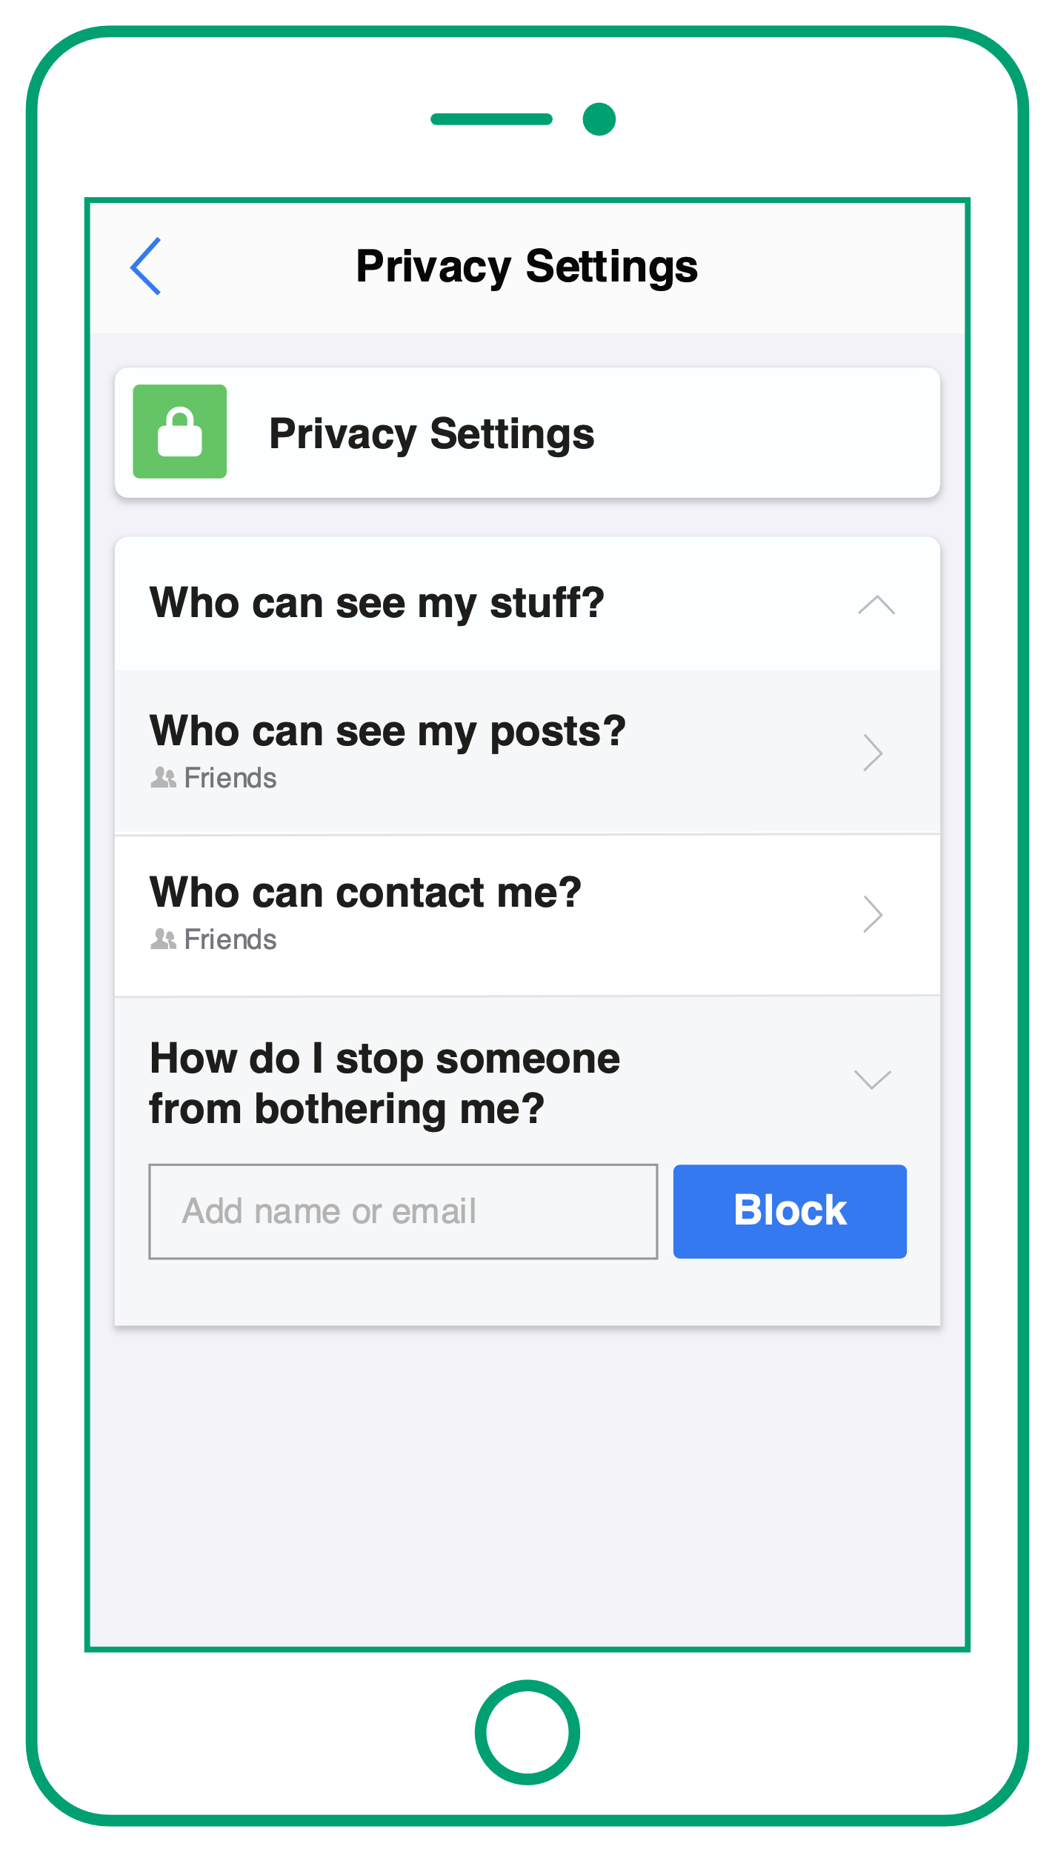
Children’s code
Privacy
1
Children and young people’s privacy setting should automatically be set to high.
Notes:
The rules (15 minutes)
Show slides 15 to 22 and talk through some of the Children’s code rules (there are 15 rules in total.) For each slide, ask students how they think the rule protects children and young people.
Q. How does this rule protect children and young people?
High privacy settings give users more control over how their data is used by apps / websites / games.
Having a private profile on social media protects a person's publicly available personal data, e.g. name, birthday and photos, from being seen by people they don’t know and may not trust.

Slide 16
Children’s code
Privacy
1
Children and young people’s privacy setting should automatically be set to high.
Question
How does this rule protect children and young people?
Notes:
The rules (15 minutes)
Show slides 15 to 22 and talk through some of the Children’s code rules (there are 15 rules in total.) For each slide, ask students how they think the rule protects children and young people.
Q. How does this rule protect children and young people?
High privacy settings give users more control over how their data is used by apps / websites / games.
Having a private profile on social media protects a person's publicly available personal data, e.g. name, birthday and photos, from being seen by people they don’t know and may not trust.

Slide 17
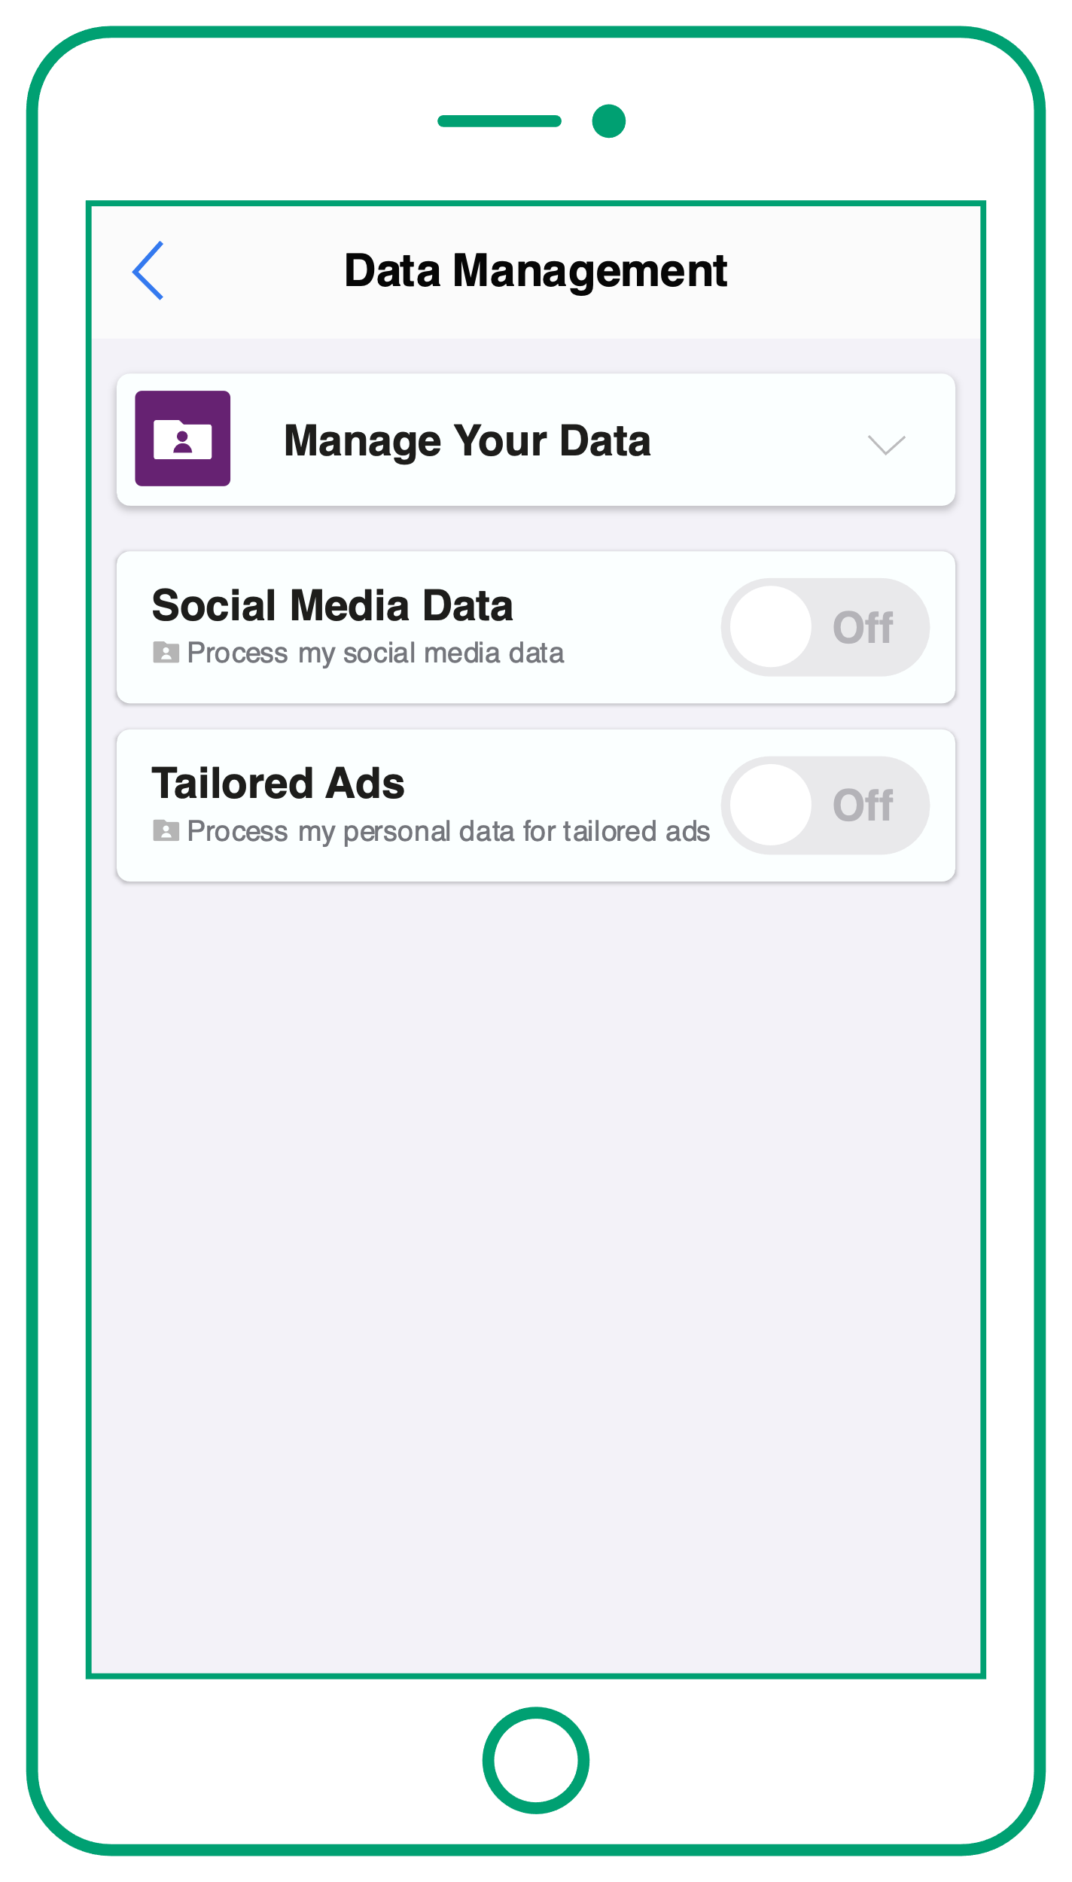
Children’s code Profiling
2
Profiling should be off by default.
Profiling is when an app or website tracks someone's online behavioural data, eg their preferences, purchasing history, what songs they listen to and what films they watch.
Behavioural data is also counted as personal data.
Notes:
The rules (15 minutes)
Show slides 15 to 22 and talk through some of the Children’s code rules (there are 15 rules in total.) For each slide, ask students how they think the rule protects children and young people.
Q. How does this rule protect children and young people?
Disabling profiling means that online companies cannot track children and young people’s activity in order to influence their behaviour e.g. by sending them notifications encouraging them to spend more time online, or by showing them targeted advertising based upon their habits / preferences.

Slide 18
Children’s code Profiling
2
Profiling should be off by default.
Profiling is when an app or website tracks someone's online behavioural data eg their preferences, purchasing history, what songs they listen to, what films they watch.
Behavioural data is also counted as personal data.
Question
How does this rule protect children and young people?
Notes:
The rules (15 minutes)
Show slides 15 to 22 and talk through some of the Children’s code rules (there are 15 rules in total.) For each slide, ask students how they think the rule protects children and young people.
Q. How does this rule protect children and young people?
Disabling profiling means that online companies cannot collect children and young people’s activity in order to influence their behaviour e.g. by sending them notifications encouraging them to spend more time online, or by showing them targeted advertising based upon their habits / preferences.

Slide 19
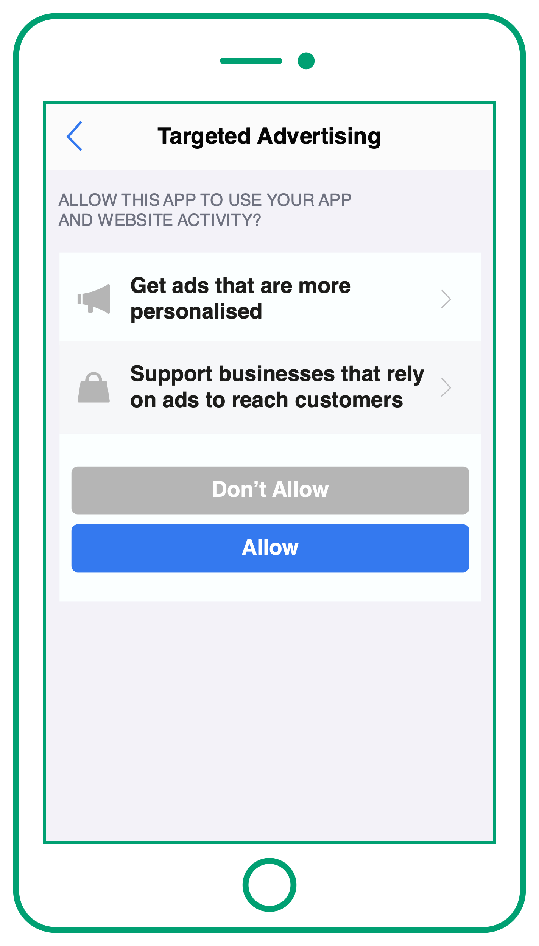
Children’s code
Targeted advertising
3
As profiling should be off by default, children and young people should not receive targeted advertising.
Targeted advertising is advertising that targets individuals based upon their age, gender, interests, online behaviour and shopping history.
Notes:
The rules (15 minutes)
Show slides 15 to 22 and talk through some of the Children’s code rules (there are 15 rules in total.) For each slide, ask students how they think the rule protects children and young people.
Q. How does this rule protect children and young people?
Disabling targeted advertising prevents children’s ‘behavioural data’ being used to encourage them to spend money and make purchases.

Slide 20
Children’s code
Targeted advertising
3
As profiling should be off by default, children and young people should not receive targeted advertising.
Targeted advertising is advertising that targets individuals based upon their age, gender, interests, online behaviour and shopping history.
Question
How does this rule protect children and young people?
Notes:
The rules (15 minutes)
Show slides 15 to 22 and talk through some of the Children’s code rules (there are 15 rules in total.) For each slide, ask students how they think the rule protects children and young people.
Q. How does this rule protect children and young people?
Disabling targeted advertising prevents children’s ‘behavioural data’ being used to encourage them to spend money and make purchases.

Slide 21
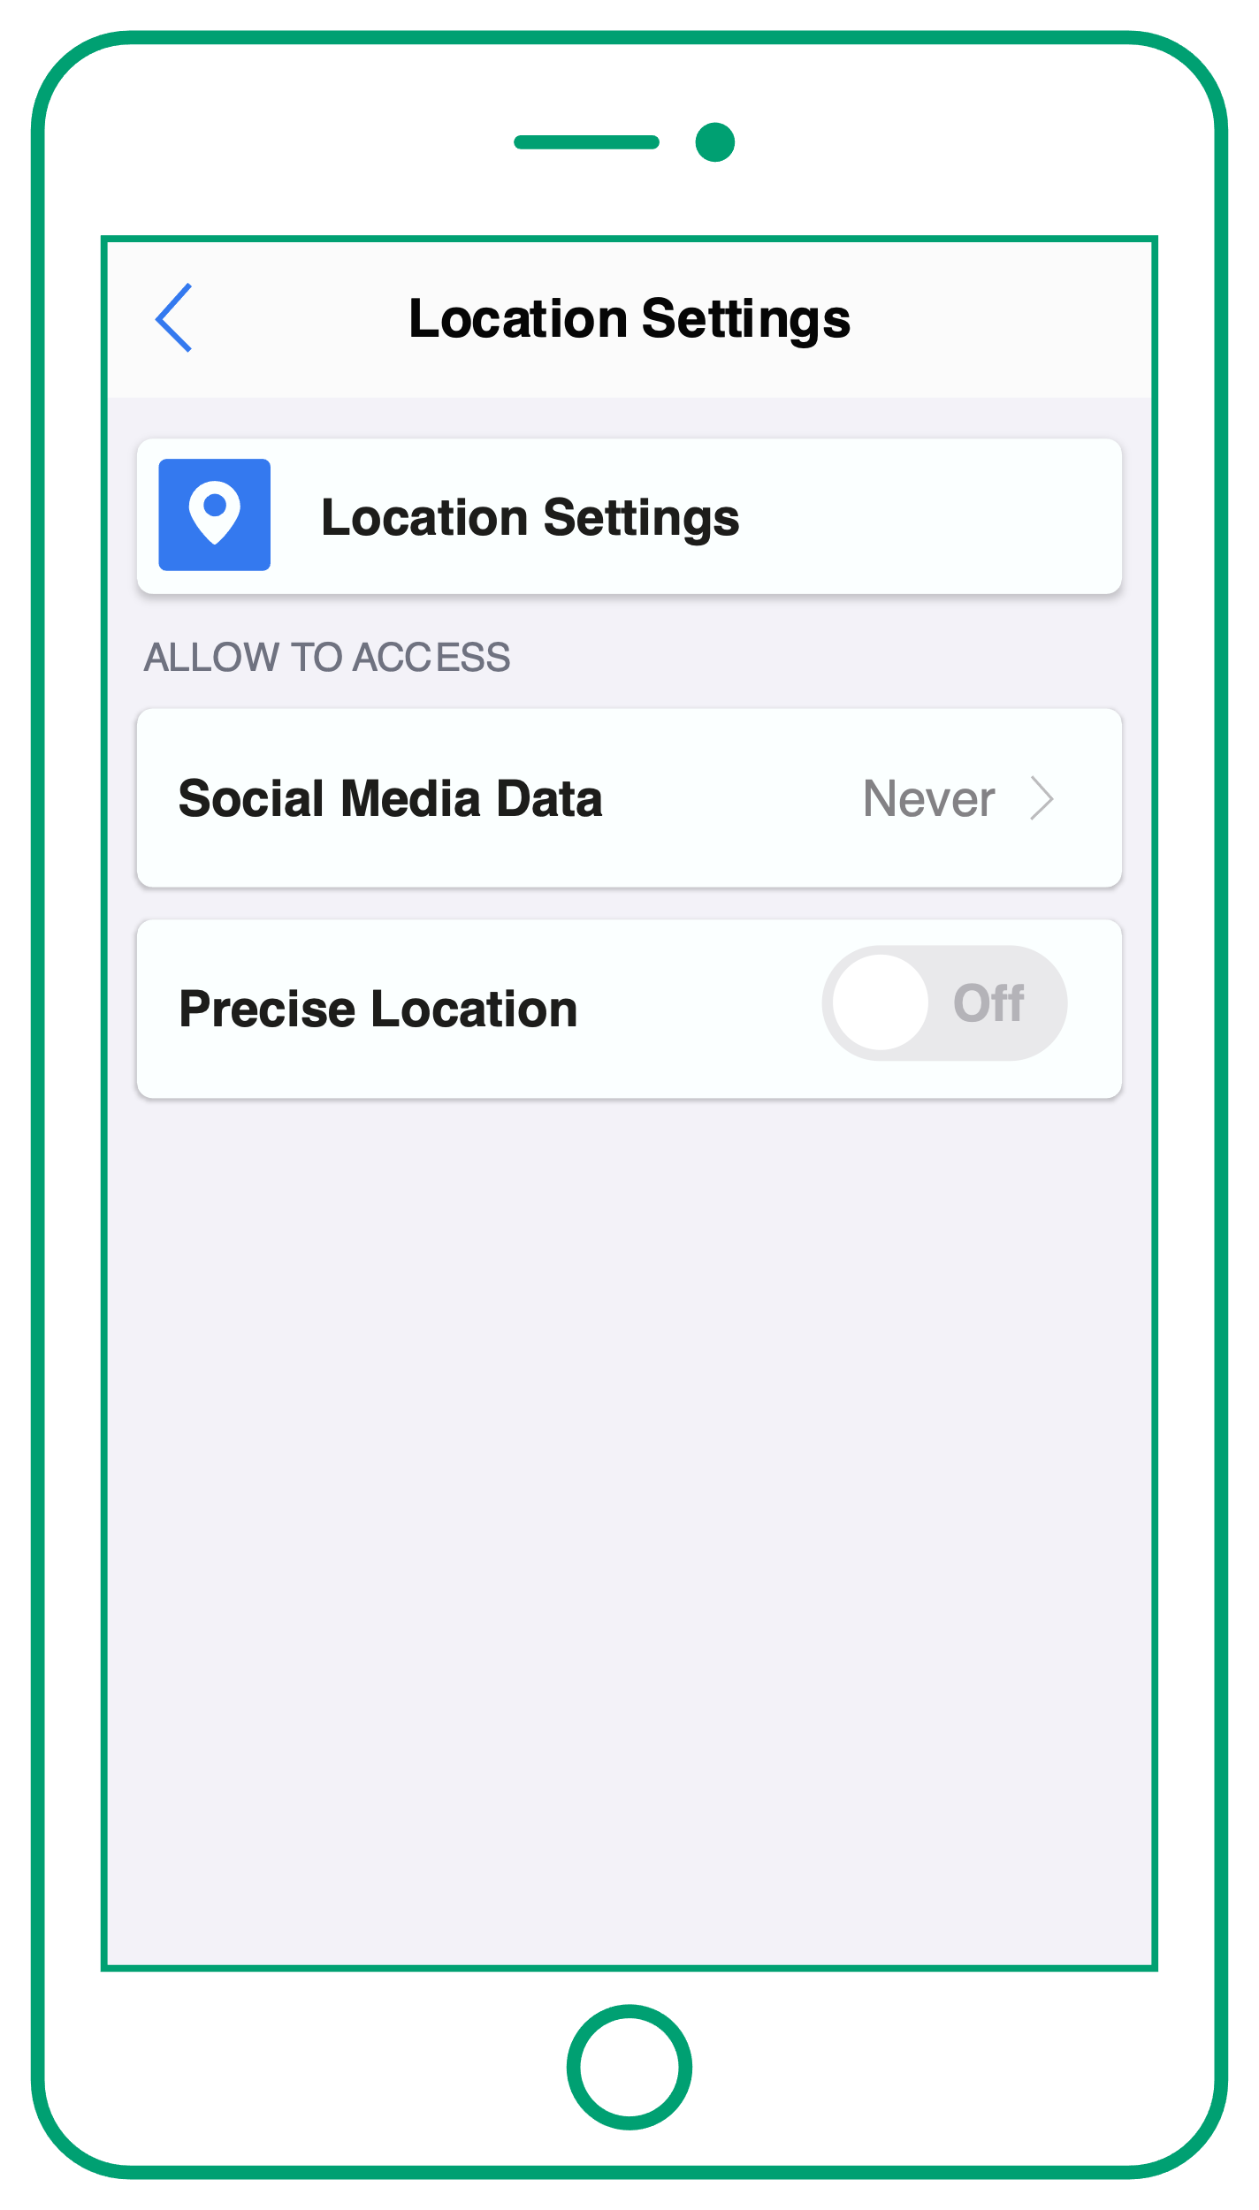
Children’s code
Location tracker
4
Children and young people’s location tracker should be automatically set to off, unless it’s really needed.
Notes:
The rules (15 minutes)
Show slides 15 to 22 and talk through some of the Children’s code rules (there are 15 rules in total.) For each slide, ask students how they think the rule protects children and young people.
Q. How does this rule protect children and young people?
Disabling location tracker keeps children and young people’s location private. This can protect them from revealing their location to other people online, for example, via social media. It can also prevent online platforms targeting them with location-based advertising e.g. advertising an event in their area.

Slide 22
Children’s code
Location tracker
4
Children and young people’s location tracker should be automatically set to off, unless it’s really needed.
Question
How does this rule protect children and young people?
Notes:
The rules (15 minutes)
Show slides 15 to 22 and talk through some of the Children’s code rules (there are 15 rules in total.) For each slide, ask students how they think the rule protects children and young people.
Q. How does this rule protect children and young people?
Disabling location tracker keeps children and young people’s location private. This can protect them from revealing their location to other people online, for example, via social media. It can also prevent online platforms targeting them with location-based advertising e.g. advertising an event in their area.

Slide 23
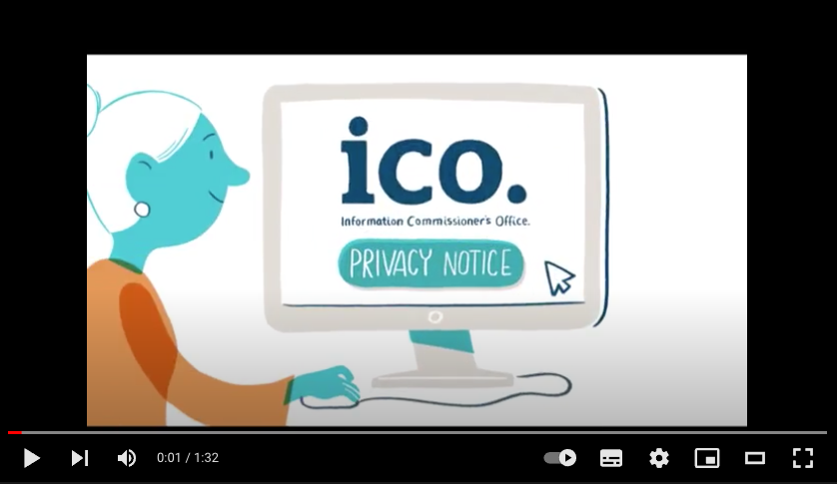
Children’s code
Privacy policy
ICO layered privacy notice
5
Websites, apps and games should explain how children and young people’s personal data will be used in language that is simple and easy to understand, for example, by using video.
This is called a ‘privacy policy’.
Notes:
Teacher notes
Some companies, such as Lego, have chosen to create videos that explain their privacy policy in easy-to-understand language.

Slide 24
Concerns and complaints
If you have concerns that an app, website or game isn’t respecting your data rights, or complying with the Children’s code, you should talk to your parent or guardian.
You or your parent or guardian can choose to make a complaint directly to the online company.
!
If you are not happy with how the company handles your complaint or you still have concerns, you can contact the ICO for more help: ico.org.uk/make-a-complaint/
Notes:
Teacher notes
Read the information on the slide to the class.

Slide 25
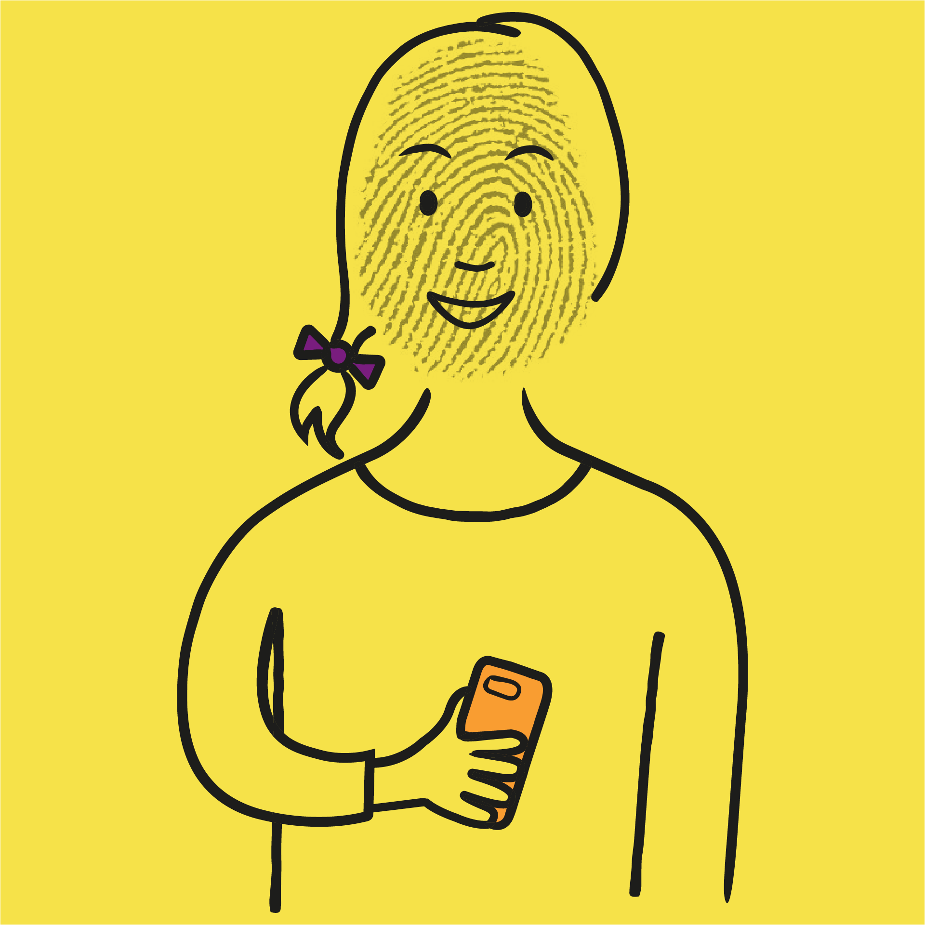
Kayla’s story
Read through Kayla’s story in pairs then:
highlight any detail that you think might be breaking the Children’s code; and
complete the follow-up questions.
Notes:
Kayla’s story (10 - 15 minutes)

Slide 26
vv
Kayla’s story
vv
Kayla is 14 and registers for an account on Skroll, a new social media platform that her friends are using. To sign up she provides her name, age, gender and email address.
On the way to school she uploads a selfie and tags her friends to announce that she has a Skroll account now. When it uploads, Kayla notices that the photo has been automatically tagged with her location. By the time she has reached school, the photo has lots of likes, including from people she doesn’t know.
After school, Kayla follows her favourite influencer, who has a new paid partnership with a trainer brand. Kayla clicks on the picture and is taken to the brand’s website.
Over the next few days Kayla keeps receiving lots of adverts for similar trainers.
Kayla needs to get a big piece of work done for school, so she decides to take a break from Skroll. That evening she receives a notification from the app saying, ‘We have missed you on Skroll. Check out what your friends have posted today!’.
She clicks on the app’s privacy policy to understand how it’s using her personal data but it’s really long and complicated, so she gives up.
Location tracker should be set to off
Kayla’s profile should be private by default
Profiling should be off so Kayla shouldn’t be receiving targeted adverts based upon her activity
Profiling should be off so Kayla shouldn’t be receiving notifications based upon her activity
Privacy policies should be written in a simple language for a young audience
Notes:
Kayla’s story
Distribute copies either of Kayla’s story scenario sheet or Kayla’s story scenario - support sheet to students working pairs.
Ask them to read the story, and highlight any detail that they think might be breaking the Children’s code or that they are not sure about.
Then, they should discuss the follow-up questions in their pairs and write down answers.
Finally, call the class back together and talk through students’ responses to the task. Show this slide which reveals the answers for the highlighting task.
Questions and answers
How does Kayla feel when she receives lots of adverts based upon her browsing history? Why do you think she feels this way? Kayla feels uncomfortable with receiving targeted advertising because she knows that the social media app has been profiling her online activity, and using it to show her adverts. She might feel that targeted advertising feels intrusive or too personal.
Why do you think the app sent Kayla a notification? Do you think this is compliant with the Children’s code? The notification is designed to encourage inactive users to re-engage with the app. The notification was sent as a result of the app profiling Kayla’s account and registering that she had been inactive. It is not compliant with the Children’s code because profiling should be disabled as a default. It is also important for young people to take social media breaks, when they need to, so sending these notifications in this way may not be beneficial to Kayla’s health and wellbeing.
What would you advise Kayla to do in this situation? Kayla should talk to a parent or carer once she realises that the app she is using is not compliant with the Children’s code. They can choose to contact the app company and report it. If they are not happy with how the matter is resolved they can contact the ICO directly: https://ico.org.uk/make-a-complaint/

Slide 27
Question box
Do you have any questions about the topics covered in this lesson?
Write them down on a piece of paper and place it in the question box at the front of the class.
Notes:
Question box (1 minute)
To wrap up the lesson, ask students to write down one question that they have learned about the topic, or it could be something they would like more information about.
The questions can be anonymous and placed into a box located at the front of the class. Address these questions in a follow-up lesson.
Endpoint assessment
Return to the baseline assessment and ask students to make any changes or additions to the mind map in a different colour pen to demonstrate what they have learned.

Slide 28
Help and support
vv
vv
For more support about any of the topics covered:
talk to your parent or carer;
have a chat with a teacher or member of school staff; or
take a look at the following websites:
ico.org.uk
thinkuknow.co.uk
vv
Notes:
Students can go to the following sites for more support about the topics covered:
https://ico.org.uk/ for more information about the Children’s code and to make a complaint
https://www.thinkuknow.co.uk/ for information about staying safe online

Slide 29
Extra challenge – spread the word
Extra challenge – spread the word
It’s important that all young people understand what the Children’s code is and why it’s relevant to them.
We would like you to work in pairs to create an informative poster as part of a campaign to make young people aged 11 to 16 aware of the Children’s code.
Your poster should explain what the Children’s code is and why it is important, in an engaging and accessible way.
Notes:
Spread the word (10 – 15 minutes)
If time allows, students can take on this extra challenge. This activity encourages students to consolidate the information they have learned by asking them to deliver to others in an clear and concise way.
Divide students into pairs and distribute the following handouts to help them create their posters:
Top tips for creating a poster campaign
The Children’s code - a summary
Students can present their posters to the class, as part of a follow-up session, and explain their approach.

Slide 30
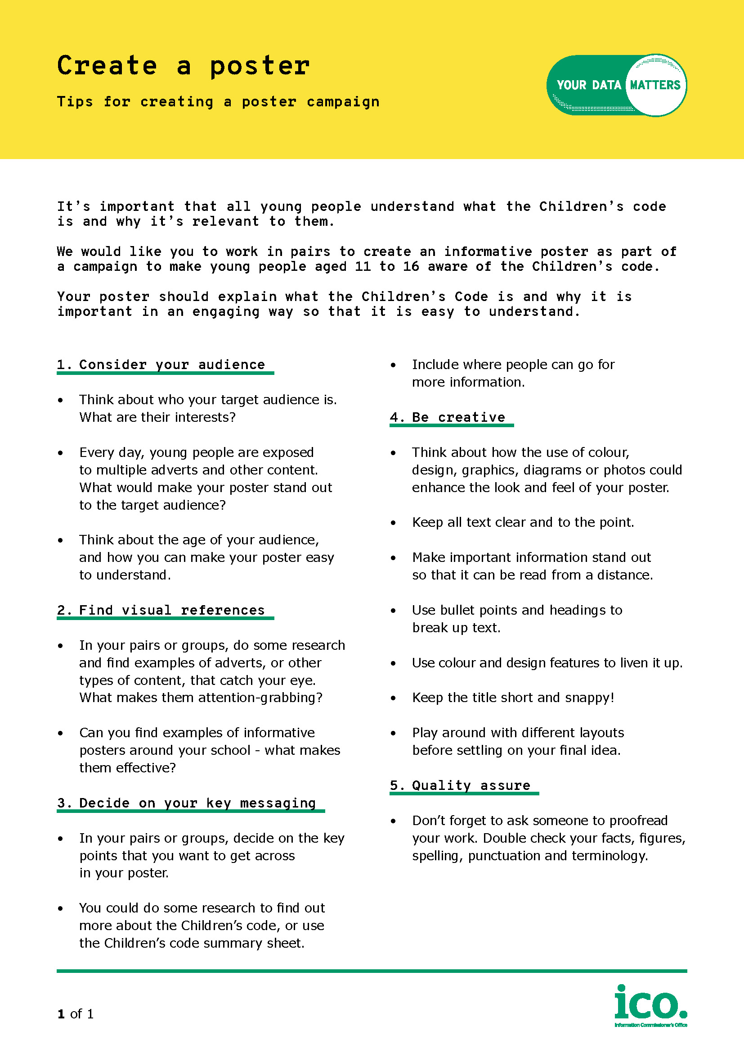
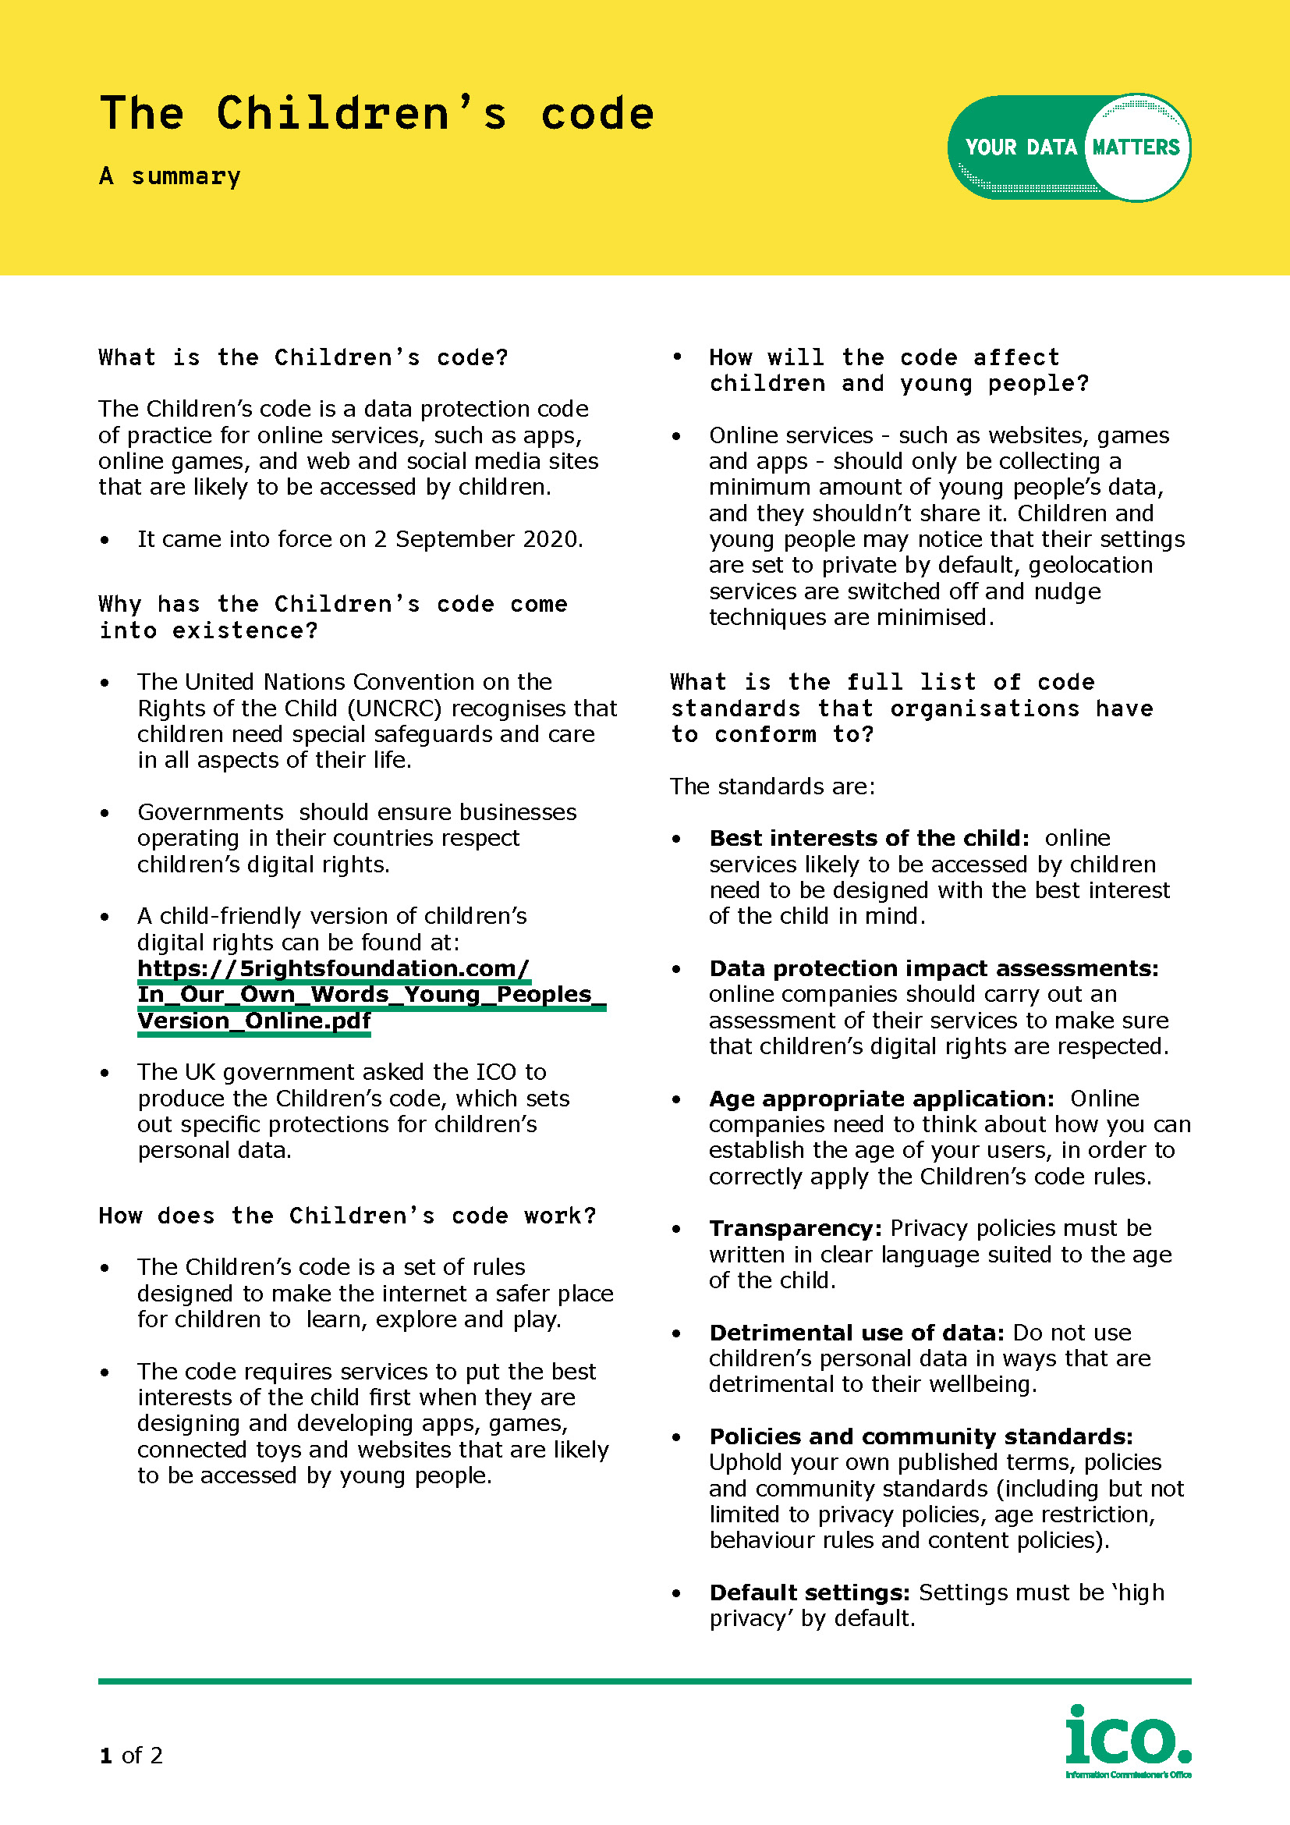
Extra challenge – spread the word
It’s important that all young people understand what the Children’s code is and why it’s relevant to them.
We would like you to work in pairs to create an informative poster as part of a campaign to make young people aged 11 to 16 aware of the Children’s code.
Your poster should explain what the Children’s code is and why it is important in an engaging and accessible way.
Extra challenge - spread the word
Use the following handouts in your groups to help you plan your poster:
Remember to keep it as simple and creative as you can!
Top tips for creating a poster campaign
The Children’s code - a summary
Notes:
Spread the word (10 – 15 minutes)
If time allows, students can take on this extra challenge. This activity encourages students to consolidate the information they have learned by asking them to deliver to others in an clear and concise way.
Divide students into pairs and distribute the following handouts to help them create their posters:
Top tips for creating a poster campaign
The Children’s code - a summary
Students can present their posters to the class, as part of a follow-up session, and explain their approach.

Slide 31
Exit tickets
On your exit tickets write down:
one thing you have learned today; and
any questions you still have.
Remember, if you have any concerns about how a website or app is using your data talk to a parent or carer. Your parent or carer can contact the website or app.
!
If your parent or carer is not happy with the response they get, they can contact the ICO for help: ico.org.uk/global/contact-us
Notes:
Plenary
To wrap up the lesson, ask students to write down one question that they have learned about the topic, or it could be something they would like more information about.
The questions can be anonymous and placed into a box located at the front of the class. Address these questions in a follow-up lesson.
Endpoint assessment
Return to the baseline assessment and ask students to make any changes or additions to the mind map in a different colour pen to demonstrate what they have learned.
Thumbs up, thumbs down
If time allows, return to the learning outcomes and do a ‘thumbs up, thumbs down’ for each to assess how comfortable the class feel with each outcome at the end of the lesson.

